Slide 1
Bengali Website Scraper
Group Members:
1. S.M. Istiak Ahmed - 1721365042
2. Efat Hossain Emon - 1711911042
CSE499B.07 Faculty: AzK

Slide 2
Problem Analysis
Web Scraping refers to data scraping used for extracting data from websites. Our project is to build a web scraper using beautifulsoup and mongodb to scrape data, mainly text, from bangla websites and store it in a database. While working on the project, we faced various problems. The most notable ones are:
Complicated and changeable web page structure
IP blocking
Scraping unnecessary information
MongoDB authorization issue
Later on, the focus of our project changed to finding and documenting how various approaches of web scraping provides different result and possibly figure an optimal approach to scrape Bengali websites.

Slide 3
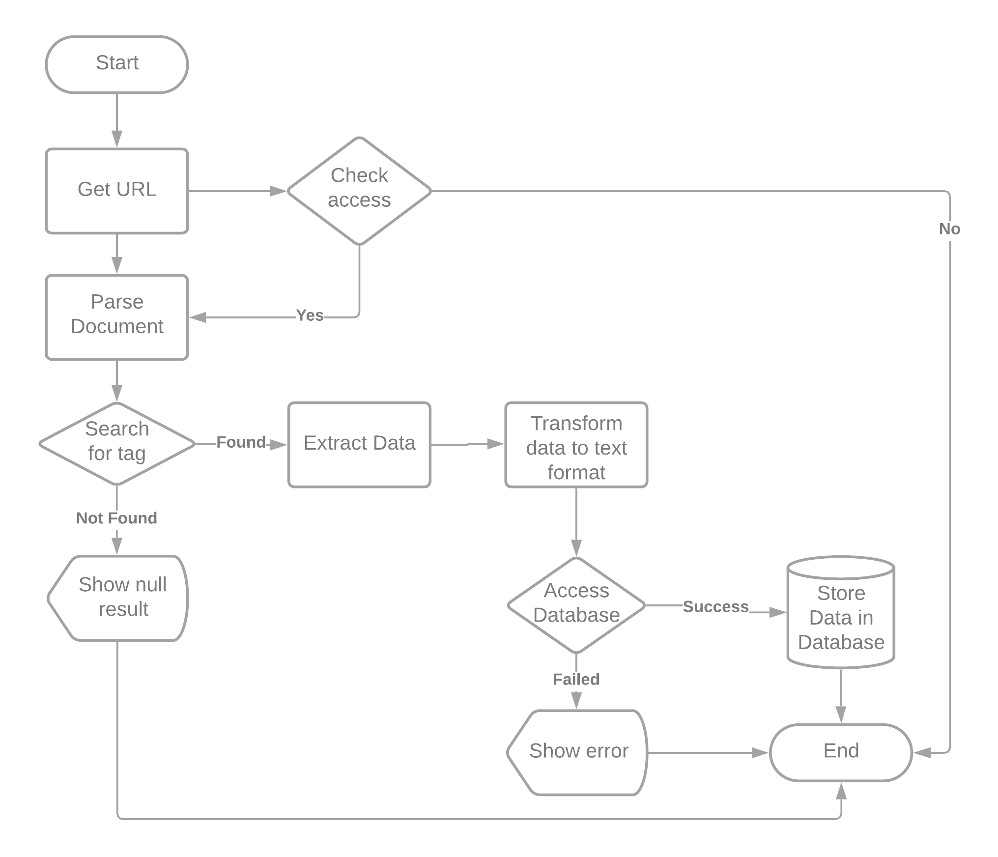
Basic Design

Slide 4
Related Works
Some of the most notable related works are described below: 1. Visual Web Ripper Visual: Web Ripper is one of the most advanced web scraping software, created by Sequentum group in 2006 that provides functionality that allows you to scrape data from any websites like Business Directories, Simple Web Pages, Classified Sites, Forums and e-commerce site scraping (eBay, amazon, magento sites). Once data scraping finish, data can be exported to structured CSV, Excel, or XML format (List of Web Harvester, Data Scraper,Web Scraping Software and Tools)
2. Web Content Extractor: Web Content Extractor (WCE) is a simple user-oriented application developed by Newprosoft. It has good wizard that guide user to setup scraper. You can scrape data from website with few clicks and Web Content Extractor is excellent for putting data into different formats like Excel, text, HTML formats, Microsoft Access database, Structured Query Language(SQL) Script File, MySQL Script File, Extensible Markup Language (XML) file, HTTP submit form and Open Database Connectivity (ODBC) Data source. (“List of Web Harvester, Data Scraper, Web Scraping Software and Tools,” n.d.) (“Software for Web Scraping,” n.d.).

Slide 5
Related Works
3.Mozanda Web Scraper: Mozanda Web Scraper is powerful web data extraction service. It can extract data from websites as well as PDFs. It has simple Point and selection interface so nontechnical can also make simple scrape. Mozenda runs your scraping project (agent) on their cloud environment which is the main difference of Mozanda from other scrapers. (“List of Web Harvester, Data Scraper, Web Scraping Software and Tools,” n.d.).
4. UiPath: Robotic Process Automation UiPath can automatically log in to a web site, extract data spanning multiple webpages, filter and transform it into the format of user choice, before integrating it into another application or web service. UiPath resembles a real browser with a real user, so it can extract data that most automation tools cannot even see (Savinkin, n.d.). No programming is needed to create intelligent web agents using its drag-and-drop graphical designer-but the .NET hacker inside you has complete control over the data (“List of Web Harvester, Data Scraper,Web Scraping Software and Tools,” n.d.).

Slide 6
Approaches Used
To fulfill the newfound focus of our project, we used 4 approaches in total to approximate how they deal with the problem of web-scraping and how their results vary. A very brief idea about the approaches are given below: a) Mimicry Approach: This a DOM selector based approach. Works best when the rules are predefined. Efficient on homogenous websites but less useful scraping heterogenous websites. b) Differential Approach: Works great in homogenous or similar websites. In essence, it only scrapes the body of the website and takes rest of the website as non-changing.

Slide 7
Approaches Used
c) Weight Measurement Approach: This approach calculates the total weight of words in each branch of the DOM tree and using deduction chooses the start and end node of the main content. It needs no training and is very adaptable to even changeable website designs. However, the results can’t be very noisy.
d) Machine Learning Approach: In this approach, we train an algorithm on a large sample of manually analyzed web pages and try to make it learn the geographical location of the text block statistically. It takes a long time to teach but is quite flexible and the result gets better with sample size.

Slide 8
Contribution
The project contributions are shown in the table below:
Name | Contribution
S.M. Istiak Ahmed; 1721365042 | Coding, Presentation, Result Analysis, Project Report
Efat Hossain Emon; 1711911042 | Project Report, Database

Slide 9
Unique Aspect
Although web-scraping is a fairly common project, there are some unique aspects in our work that makes it worth our time.
Firstly, this web-scraping project is heavily designed to work on the bangla websites and scrap bangla text articles only. Secondly, this project hopes to use the outcome to categorize and store the scraped data so it may be of use in future works or at the very least - act as a warehouse of bangla text contents of various categories.
Finally, it also gives us a conclusive result regarding which approach is best to scrape bengali websites.

Slide 10
Tools Used
We used several tools while working on this project. The most important ones are listed below:
Spyder IDE: Initially we worked using pyCharm but due to importing issues faced in that IDE, we switched to Spyder
BeautifulSoup: We used the beautifulsoup python library to scrap the data from the websites
MongoDB: We connected an api of mongodb with the project to store the scraped data in database TensorFlow: We used tensorflow to train the machine learning approach Excel: We used excel to keep track of the results and tested websites.

Slide 11
Result Analysis
For the results, we have taken around 100 bengali websites and tried scraping their data using the four approaches mentioned before. We calculated the success rate, total time taken and the accuracy of the scraped data and converted it into a bar chart. The machine learning approach has faulty results as the sample size is still small and needs more sample and time to achieve optimal result.

Slide 12
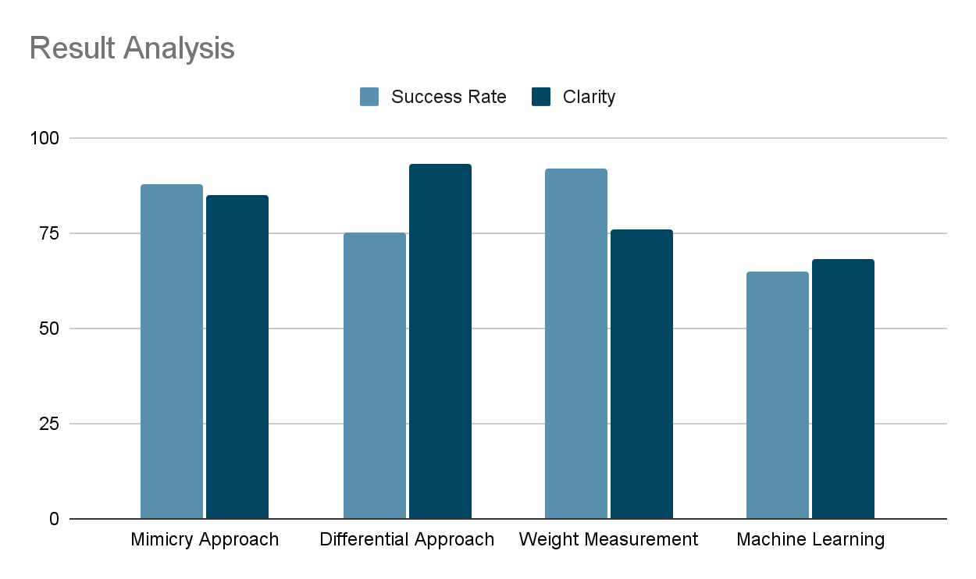
Result Analysis

Slide 13
Conclusion & Future Work
We would like to continue working on this project and hopefully turn it into a paper dedicated to finding out how the different approaches of web scraping gives us different results for scraping bengali website and how it differs from traditional english website scraping approaches and their success rates. We would also like to increase the total number of tested websites and increase the sample size for the machine learning approach.

